Slide 1

BUILDING A BUS TICKET BOOKING SYSTEM
Member: Nguyễn Minh Nguyệt - 23010408
Lò Bảo Duy - 23010096
Teacher: TS. Vũ Quang Dũng
Notes:
1

Slide 2

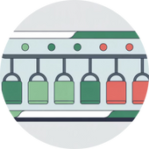


Mục Tiêu Hệ Thống
Easy Online Ticket Booking
Real-Time Seat Availability Display
Secure Payment Integration
Scalable & Reliable System
Provides an intuitive and user-friendly interface, allowing passengers to book tickets anytime, anywhere.
Ensures that online payment transactions are secure and customer information is protected.
Builds a flexible architecture capable of handling large numbers of users and data while maintaining high performance.
Ensures seat availability information is always accurate and updated instantly.
Notes:
2

Slide 3
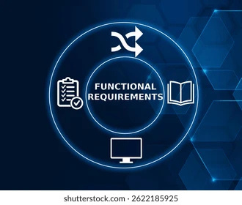
Core Functional Requirements
User Authentication (JWT)
Ensures user information security through JSON Web Tokens.
Route & Schedule Search
Allows passengers to easily search for routes and departure times.
Seat Selection & Locking
Enables passengers to select seats and temporarily lock them to prevent duplication.
Online Payment (SePay)
Integrates a secure and efficient payment gateway.
Booking History
Stores and displays detailed records of users’ previous booking transactions.
Admin Management
Provides administrators with tools to manage the system, routes, and users.
Notes:
3

Slide 4
Non-Functional Requirements (Quality Attributes)
Scalability
Availability
Supports over 10,000 concurrent users smoothly.
Ensures 99.5% uptime so the service remains consistently accessible.
Performance
Consistency
Maintains response times under 500ms to deliver a fast user experience.
Prevents duplicate bookings, ensuring each seat can only be reserved once.
Security
Uses JWT and webhook authentication to protect data and transactions.
Notes:
4

Slide 5
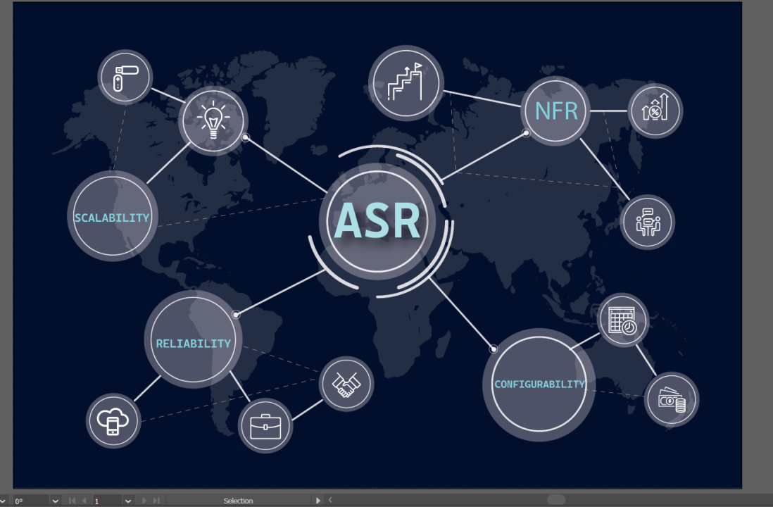
Architecture Significant Requirements (ASRs)
Real-Time Seat Locking
Reliable Payment Integration
Uses a Redis-based distributed locking mechanism.
The lock has a 5-minute Time-To-Live (TTL).
Prevents duplicate seat reservations.
Webhooks ensure idempotency.
Uses Kafka to process payment events asynchronously.
Guarantees every transaction is processed accurately and exactly once.
Notes:
5

Slide 6
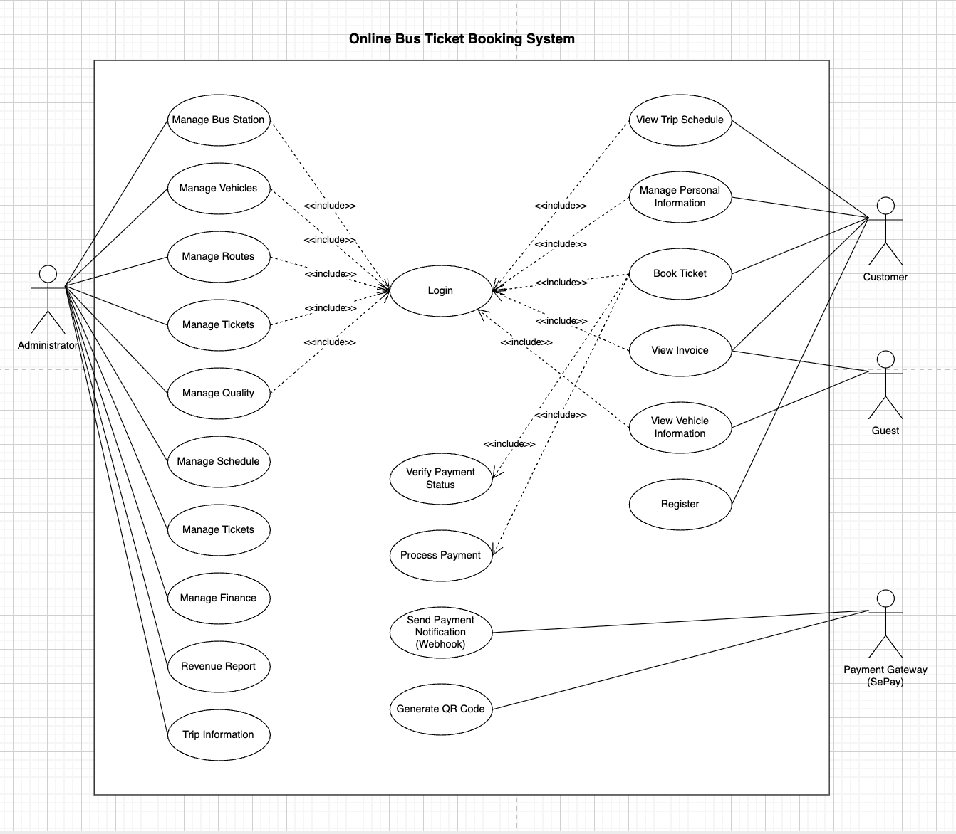
Use Case Diagram
Sơ đồ này minh họa các tương tác chính giữa hành khách, quản trị viên và cổng thanh toán. Hành khách có thể tìm kiếm, đặt vé và thanh toán; quản trị viên quản lý hệ thống; và cổng thanh toán xử lý giao dịch an toàn.
Notes:
6

Slide 7
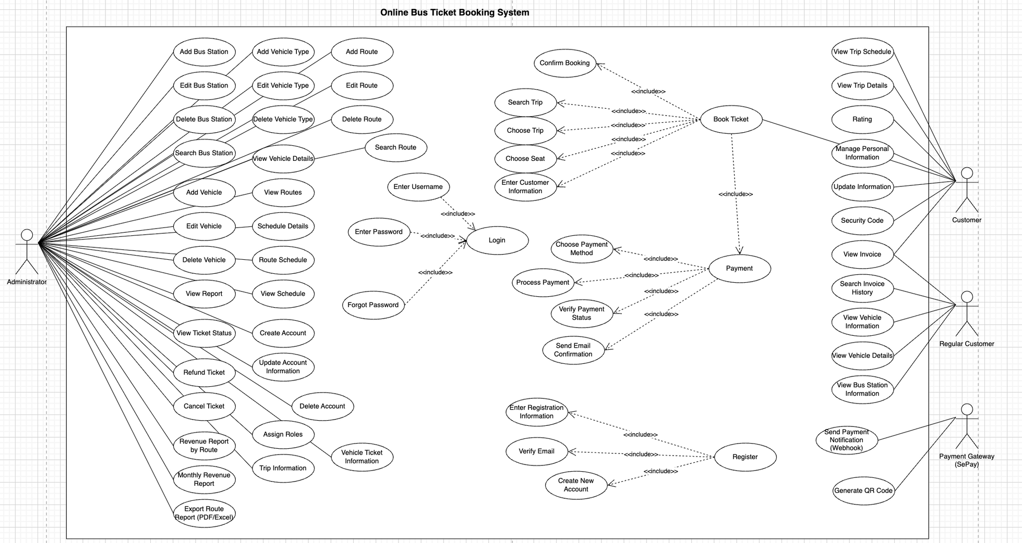
Use Case Diagram
Notes:
6

Slide 8





Architecture Style Selection
We adopt a combination of Microservices and Event-Driven Architecture to build the bus ticket booking system.
Loose Coupling
Independent Scalability
Services operate independently, minimizing interdependencies.
Each service can scale based on specific demands without affecting others.
High Reliability
Easy Deployment
Better fault tolerance and resilience when individual services fail.
Enables fast and efficient service deployment and updates.
Notes:
7

Slide 9
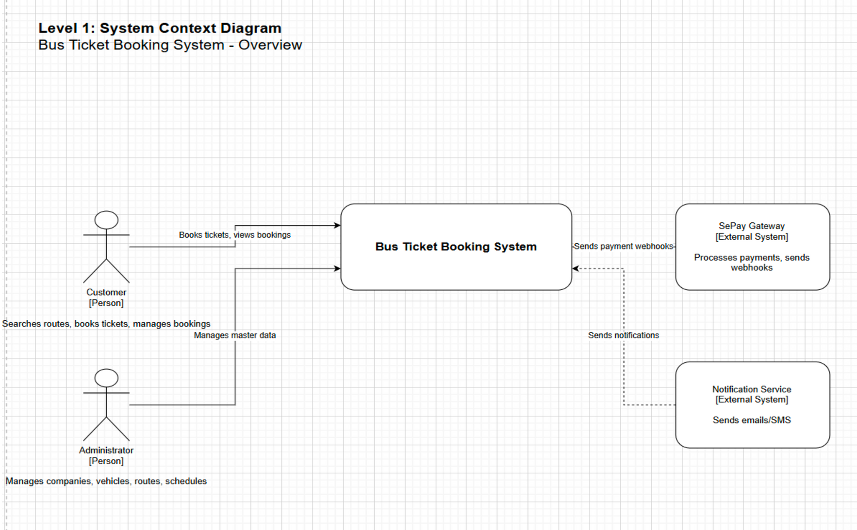
Overall Architecture (C4 Level 1 – System Context Diagram)
Process payments and refunds
Notes:
8

Slide 10
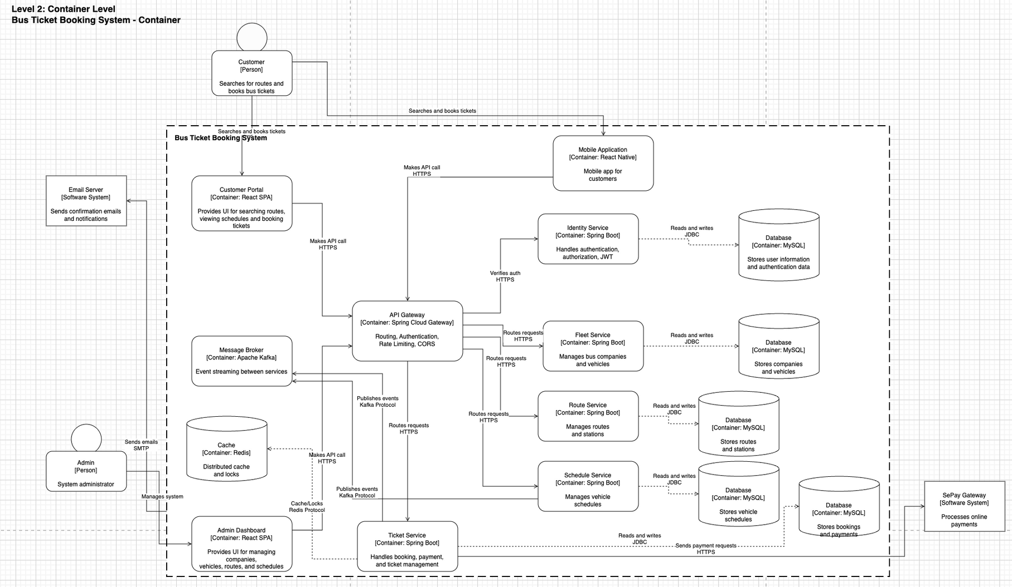
Overall Architecture (C4 Level 2– Container Level)
Process payments and refunds
Notes:
8

Slide 11
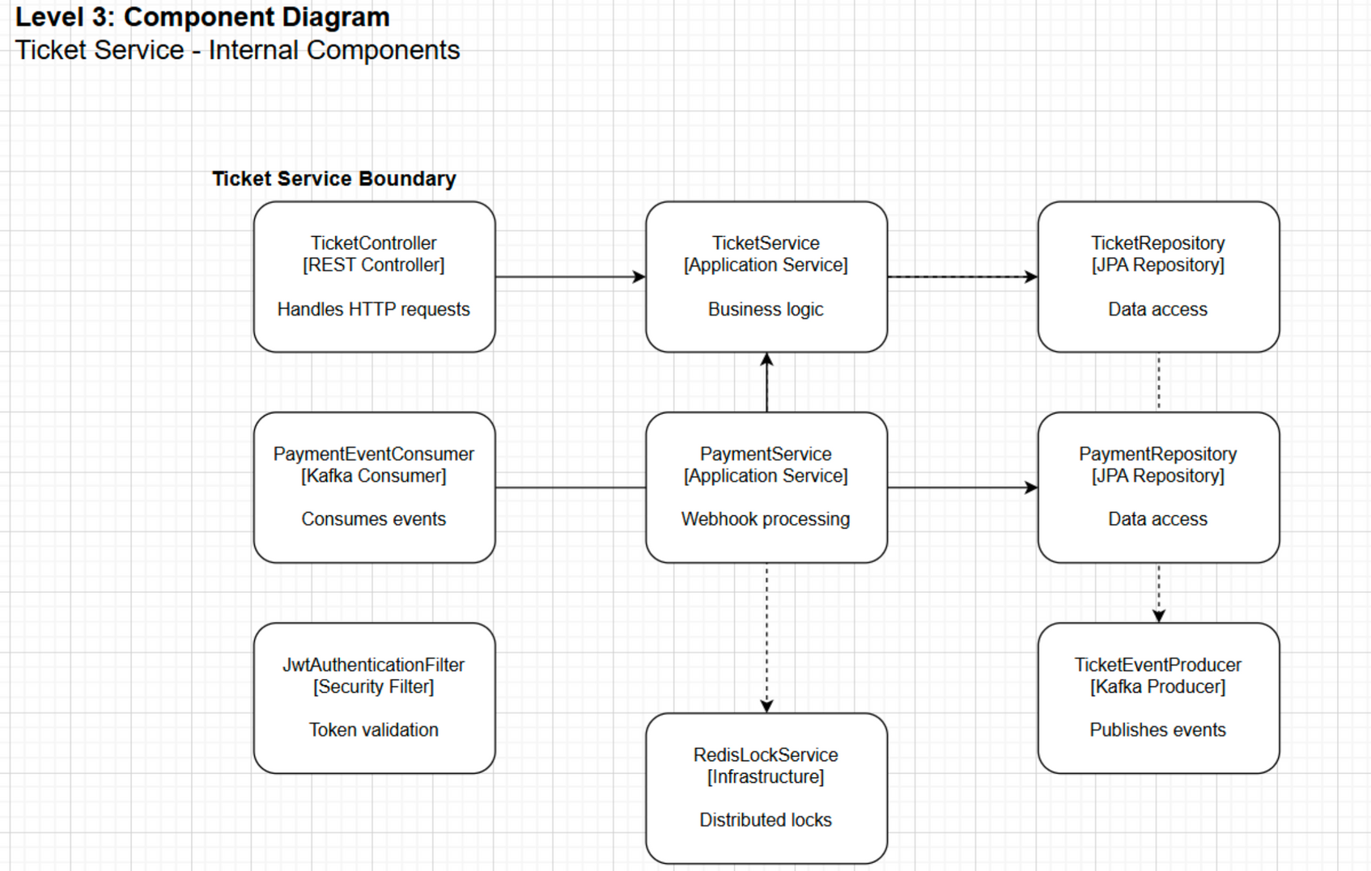
Overall Architecture (C4 Level 3 – Component Diagram)
Process payments and refunds
Notes:
8

Slide 12
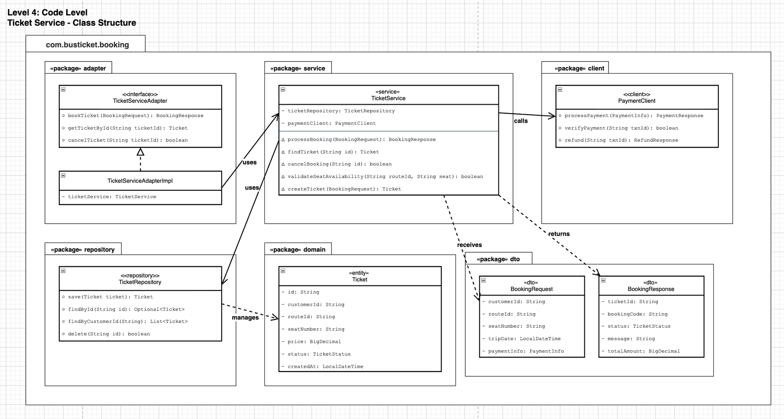
Overall Architecture (C4 Level 4 – Code Level)
Process payments and refunds
Notes:
8

Slide 13
Microservices Decomposition
Identity & Auth | Manages user identities and JWT authentication.
Fleet | Manages fleet and vehicle information.
Vehicles | Maintains detailed records for each bus.
Route & Stations | Manages routes and bus stops.
Schedule & Timetables | Handles trip schedules and timetables.
Ticket Booking | Processes ticket bookings and seat locking.
Gateway | Routes requests to the appropriate microservices.
Notes:
10

Slide 14
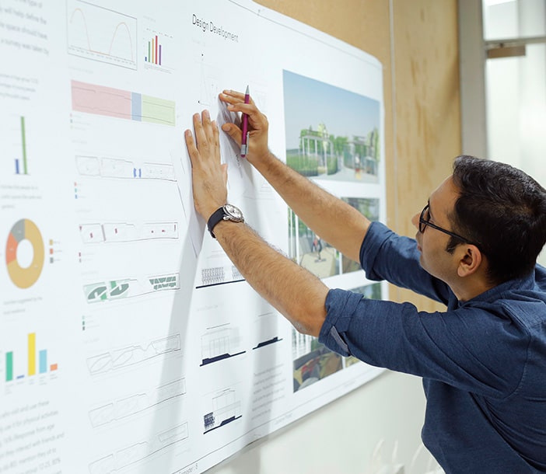

Communication Design
Synchronous
Uses REST through an API Gateway. Suitable for requests that require immediate responses, such as data queries or user authentication. Ensures real-time data consistency.
Asynchronous
Uses Kafka-based events.Ideal for time-consuming tasks or complex workflows where immediate responses are not required. Improves system scalability and fault tolerance.
Notes:
11

Slide 15
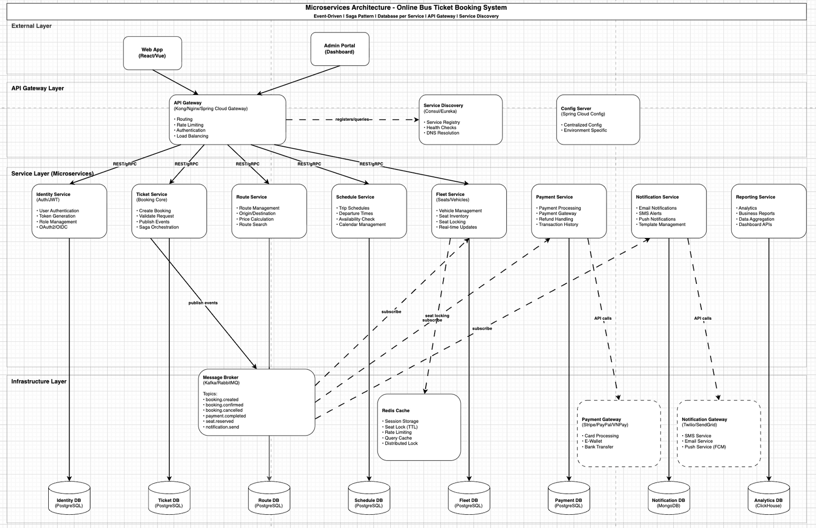
Event Flow Diagram
Notes:
12

Slide 16



Seat Locking Mechanism (Redis)
Successful Payment → Release
Time-To-Live (TTL)
Seat Locking
A TTL is set for the lock. If the user does not complete the payment within this period, the lock automatically expires.
After a successful payment, the lock is released and the seat is confirmed as booked.
This prevents duplicate reservations and ensures data consistency.
When a user selects a seat, it is temporarily locked in Redis to prevent others from booking it simultaneously.
Benefits: Prevents conflicts and double bookings, providing a smooth and reliable user experience.
Notes:
13

Slide 17

Deployment Stack
1
Backend
Node.js / Spring Boot
2
API Gateway
Single entry point for all services.
3
Kafka
Handles asynchronous event processing and data streaming.
4
Redis
In-memory cache for high-speed operations.
5
MySQL
Relational database for persistent data storage.
6
Web client
User interface built with JavaScript.
Notes:
14

Slide 18
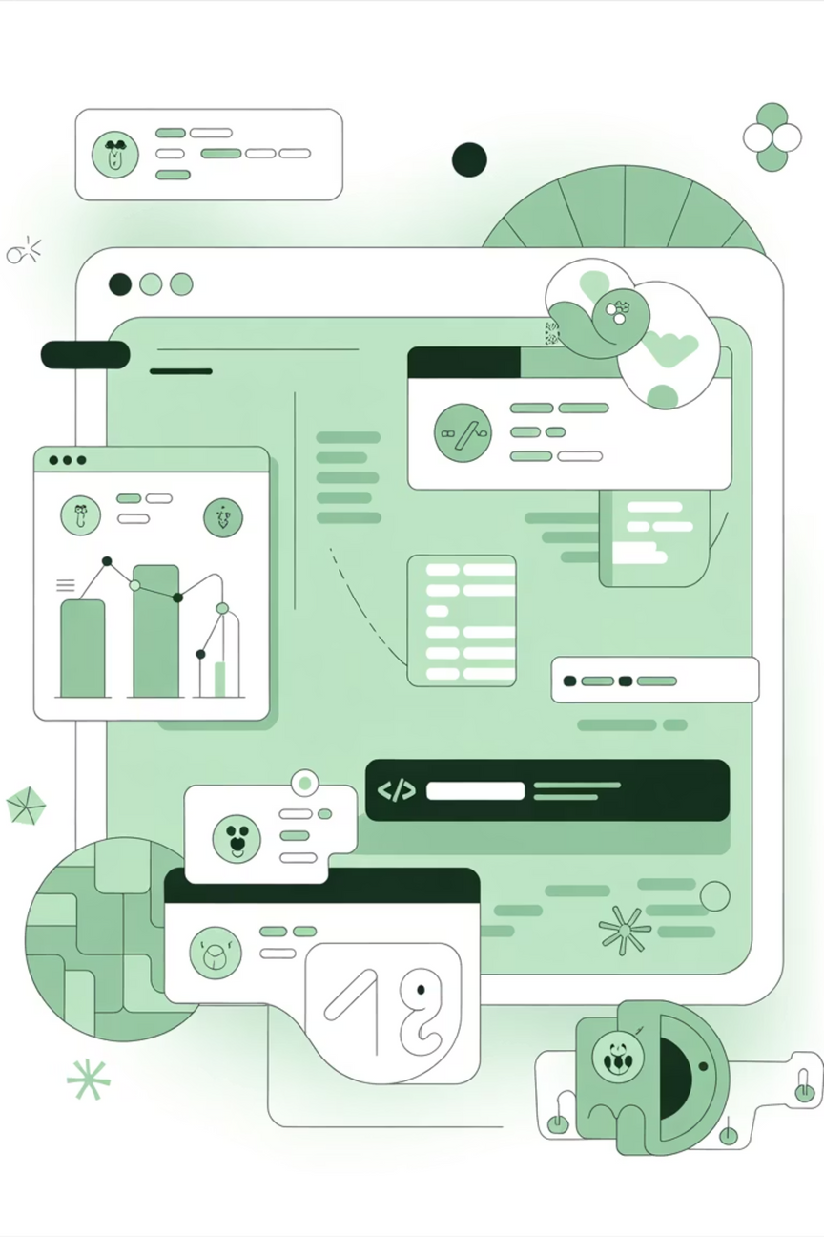
Testing & Validation
1
2
Concurrent Booking Test
Real-Time Update Test
Ensures the system can handle multiple booking requests simultaneously without errors.
Verifies that status updates are delivered to users instantly.
3
Payment Webhook Test
Ensures the payment integration operates accurately and securely.
Result: No duplicate bookings and fast response times.
Notes:
15

Slide 19
Achievements & Lessons Learned
Achievements
Lessons Learned
Microservices Decomposition
Microservices Increase Complexity
Split the system into independent services, making it easier to manage and scale.
Despite many benefits, microservices introduce additional operational and management challenges.
Event-Driven Resilience
Kafka Improves Decoupling
Leveraged Kafka to improve system resilience and fault tolerance.
Kafka enables services to work more independently, reducing tight dependencies.
Distributed Locking
Redis Is Essential for Concurrency
Implemented Redis-based distributed locks to prevent concurrency issues.
Redis plays a critical role in efficiently handling concurrent requests.
Notes:
16

Slide 20
Future Improvements & Conclusion
Future Improvements
Conclusion
Our system is designed to be scalable, reliable, and capable of handling real-time transactions.
We are committed to continuously improving and evolving the platform to meet increasing demands.
Kubernetes
Circuit breaker
Logging & Tracing
Chatbot
Caching Optimization
Notes:
17

Slide 21
THANK YOU
Notes:
17

